Slide 1
CST499 Final
Israel Balderas
Capstone for Computer Software Technology
University Of Arizona Global Campus
Professor: Amjad Alkilani
November 16, 2021

Slide 2
Scope
Things covered
Programming languages used
ULM Diagram
Functions for manipulating data
Things not covered
Development of the sites
Site layout style
Use of CSS

Slide 3
Student Center Application
The student center is a system that will allow new and current students to be able to manage there courses online. Students would be able to utilize these systems to register here utilizing their current student ID and a unique password or allow them to register for an account that will be forwarded to admissions for review. Once registered, they will be able to log into the school portal and view their current class schedule. The student portal will also be utilized for students to register for upcoming semester classes or make any changes to current classes as needed. In this document, we will cover the necessary requirements identified to successfully implement this system.

Slide 4
Functional Requirements
Student Registration
User login
View Available Classes
Add a class
View Enrolled Classes
Drop a class

Slide 5
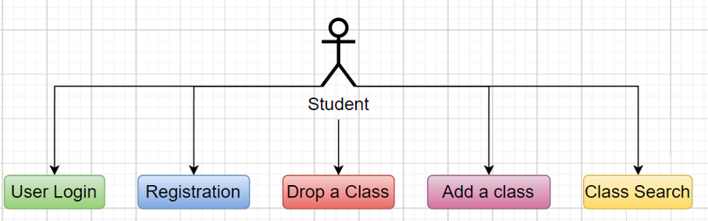
Use Case

Slide 6
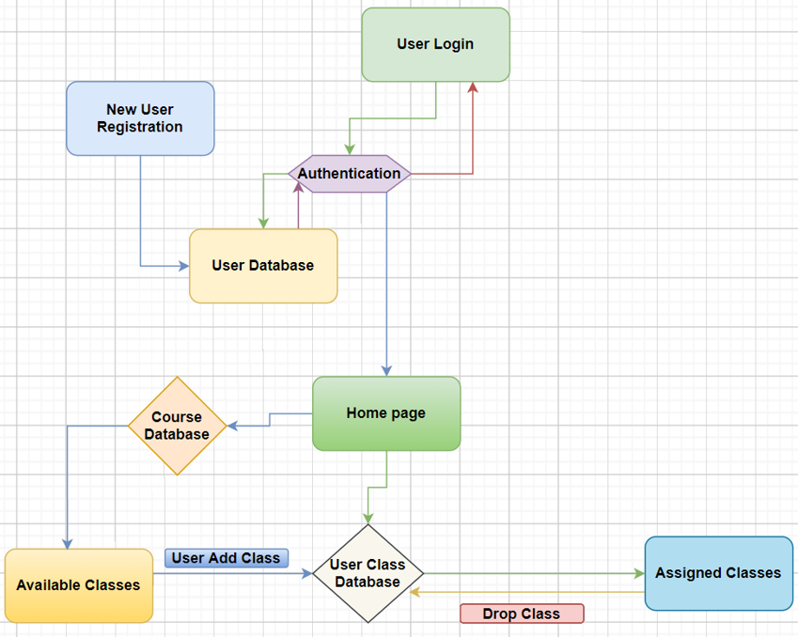
Activity Diagram

Slide 7
PHP and MYSQL
PHP is an open-source scripting-language that can have many applications but its best used in web development. There are several benefits of utilizing PHP for development one being its cross-platform meaning you can develop it on windows, linux or Mac. Secondly it is a very easy to language for beginners as well as having a big online community for support.
MySQL is an open-source relational database management system that comes installed with XAMPP. This database is simply a collection of structured data, data can be stored in tables, and then relationships developed between different tables. This allows for access to one table to allow reach over to another table.
To deploy these systems we will be installing XAMPP, XAMPP is a cross-platform system based on Apache distribution and used by developers to run local web servers. PHP and MYSQL happens to be two of the platforms that come with XAMPP and is programmed to run.

Slide 8
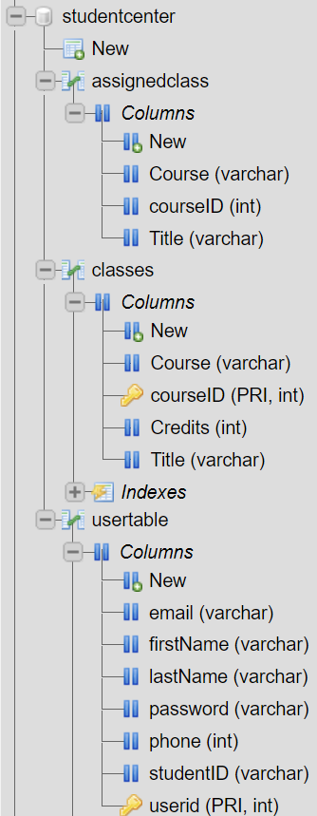
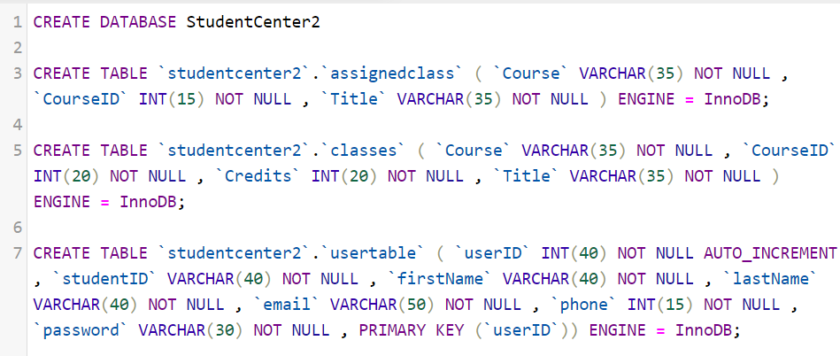
MYSQL Commands
Create- commands allows us to create a new items such as database or new tables.
Alter- Is used to modify information in a database
Insert- Is used to input information into one of our database tables
Select- Selects information from one of the tables
Delete or Drop- are used to remove information from database.

Slide 9
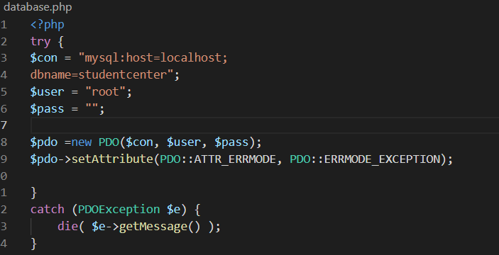
PHP Functions
Establish a connection to the Database used throughout most of the database files.
PHP Data Object(PDO)- Used to establish a connection to an existing database.
$_POST – Used to collect form data after submitting
Form – An HTML tag that allows users to provide an input, these inputs can then be used to edit the database.
Form Action – Is uses to specify where the captured data is send to for processing.

Slide 10
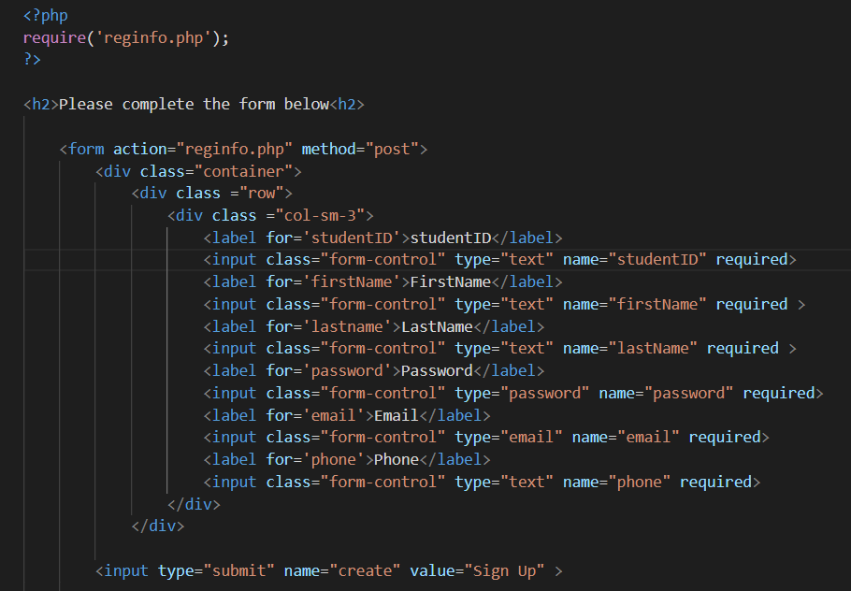
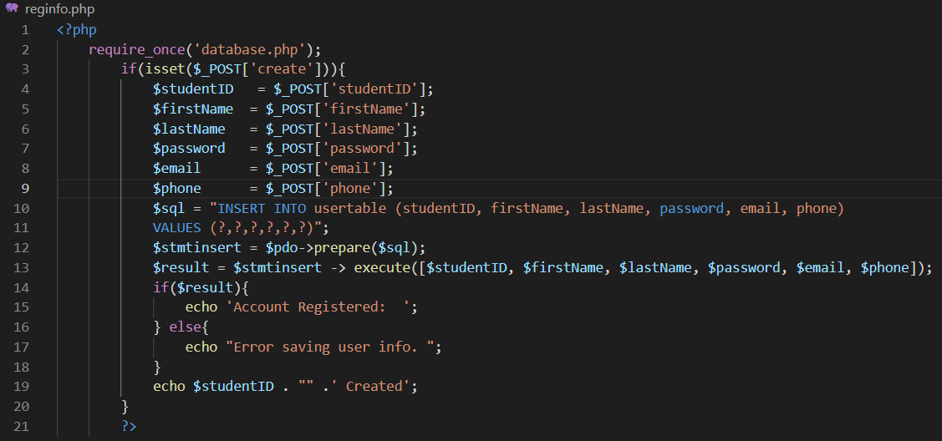
Code for registration page for capturing user information utilizing form.
Code that captures the entered information and passes it into the userTable in the MySQL database.

Slide 11
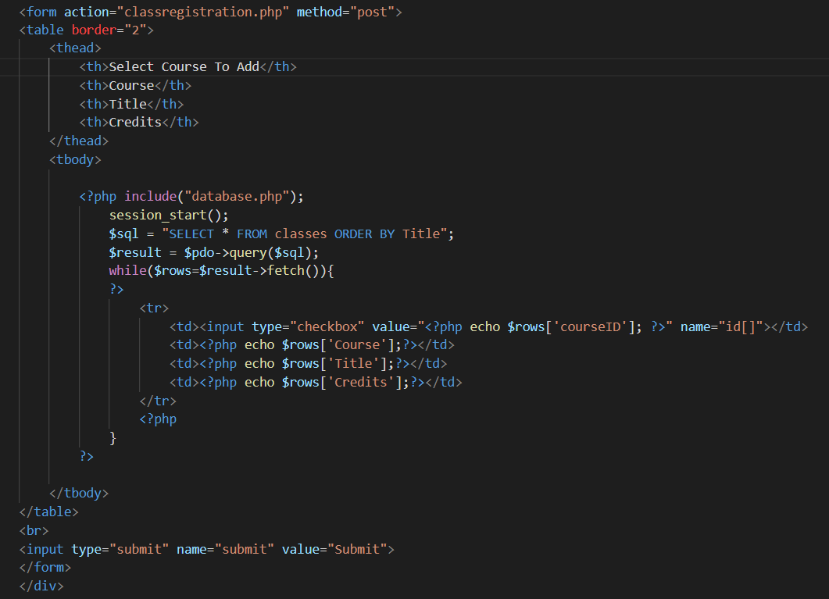
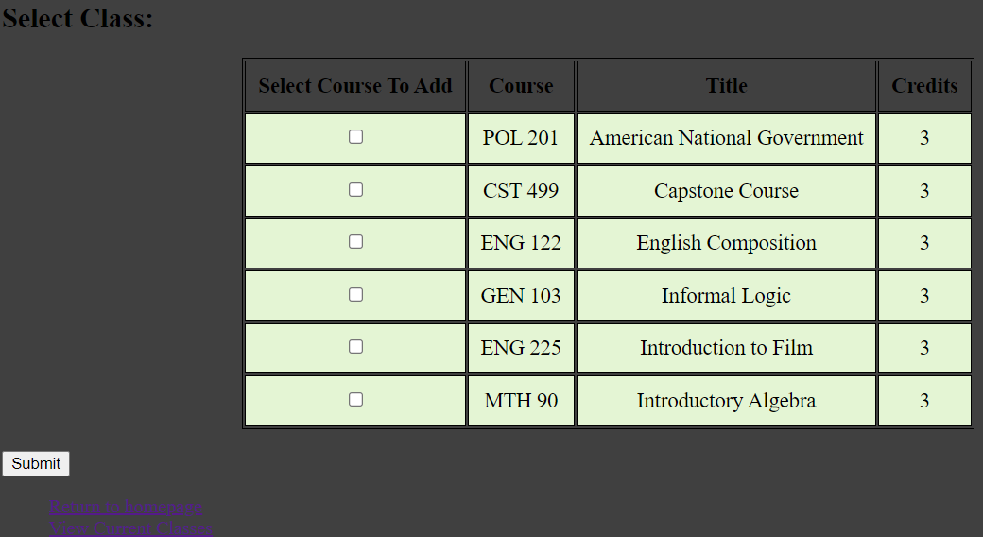
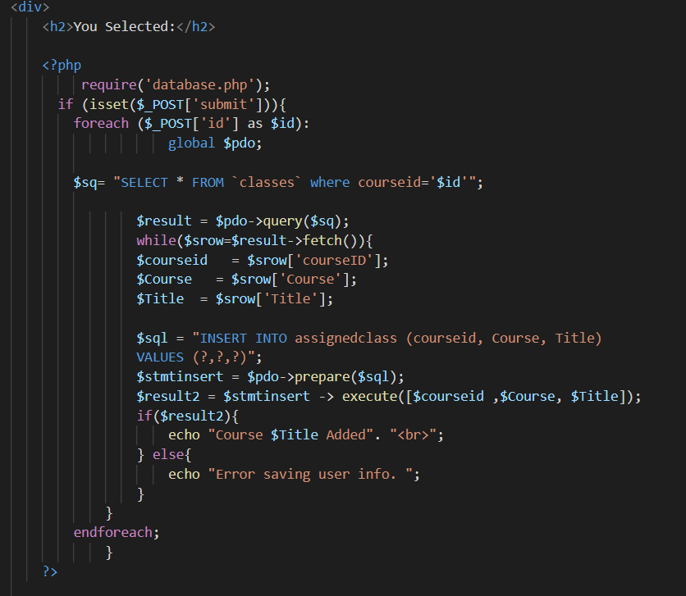
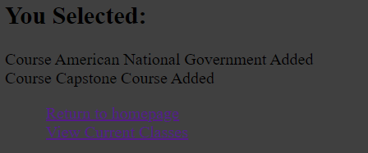
Available Courses and adding a course

Slide 12
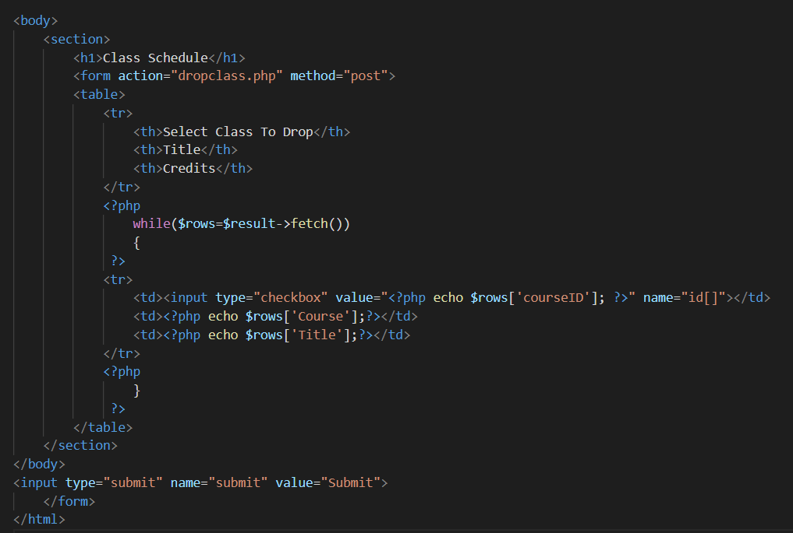
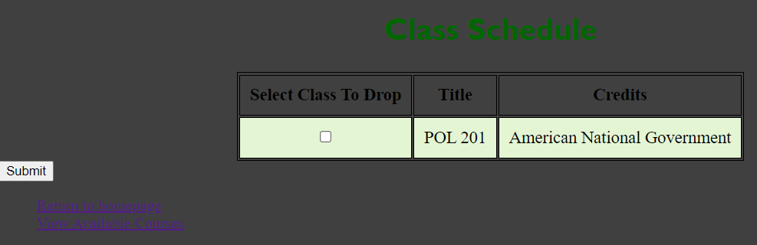
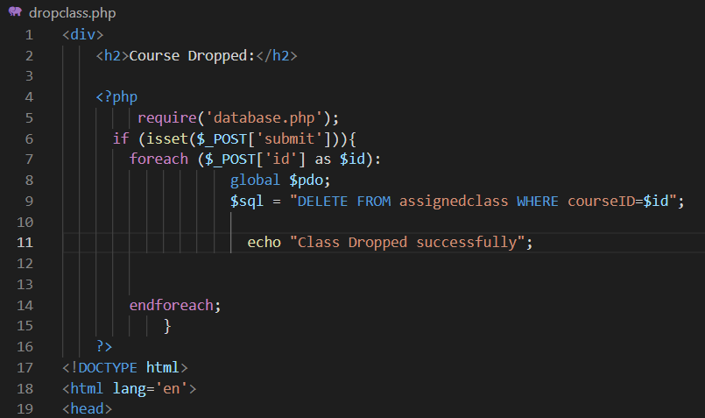
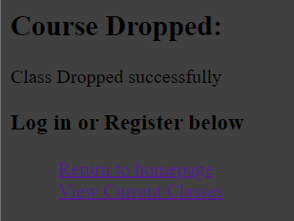
Current courses and dropping a course

Slide 13
End

Slide 14
References
Gebretsadik, K. K. (2020, May 22). Challenges and Opportunity of UML Diagram for Software Project development as a complete Modeling Tool. http://www.iosrjournals.org/. http://www.iosrjournals.org/iosr-jmca/papers/Vol7-Issue3/Series-1/H07034648.pdf.
Mikoluk, K. (2013, September 18). XAMPP tutorial: How to use XAMPP to run your own web server (Links to an external site.) [Blog post]. Retrieved from https://blog.udemy.com/xampp-tutorial
Tsui, F., Karam, O., & Bernal, B. (2018). Essentials of software engineering (4th ed.). Jones & Bartlett Learning.

